Slide 1
Long Term Impact of Research articles on social media using altmetrics
BY – Abdul Rahman
Manohar sai jasti
Murtuza Shahzad
Abhinav Chamallamudi

Slide 2

Problem significance
Majority of the articles published would sometimes have a very low lifespan and the effort put in the research article would have less recognition.
The prediction of the lifespan of any article would help in avoiding that issue and provide insight on how to properly move ahead with the publication of the article.

Slide 3

Can Altmetrics predict the long term impact of an article on social media platforms?

Slide 4
Rise of social media platforms
More than 1.3 billion people started using social media – that’s a rise of 88% in just five years, and equates to more than 8 new users every second
The number of social media users worldwide in 2018 is 3.196 billion, up 13 percent year-on-year

Slide 5
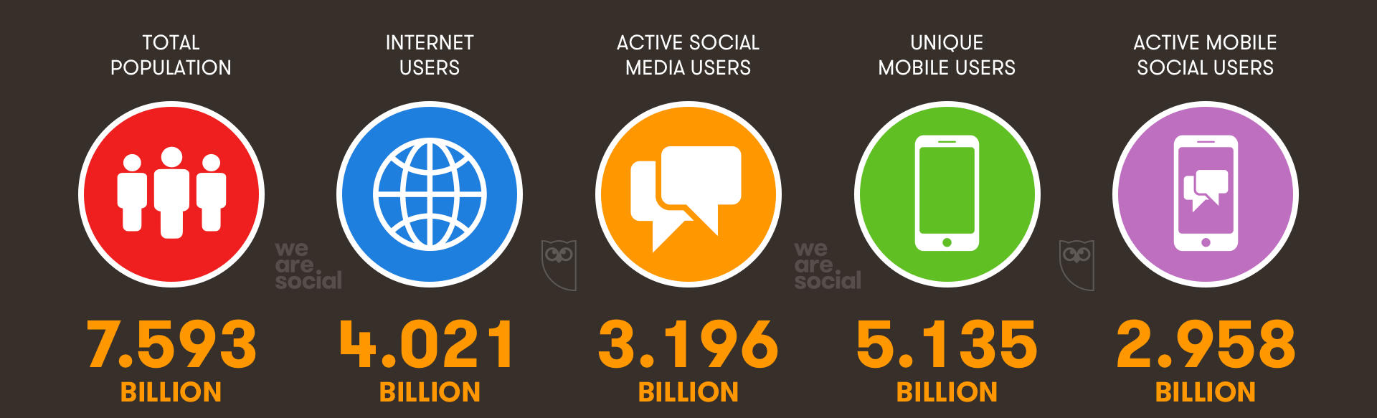
Digital around the world

Slide 6
Related works
In a study by Thelwall and Nevill the features in the Altmetric.com dataset were used to predict the importance/attention a paper can get in terms of future citation counts. They found that Mendeley reader counts are constant indicators of future citation count an article will receive.
Could scientists use Altmetric.com scores to predict longer term citation counts?
Lariviere observed that the typical citation life cycle of an article starts with a rapid increase during their initial years on the scientific scene, followed by a peak, and then a slow but steady fall into oblivion.
Long-term variations in the aging of scientific literature

Slide 7

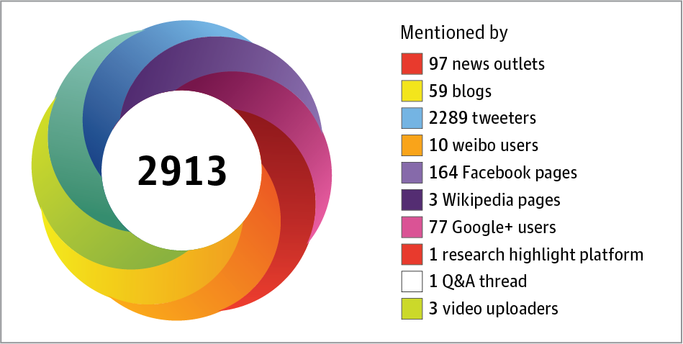
Capturing the online attention surrounding scholarly content
Article-level metrics have been proposed as a complement to scholarly metrics such as citations, the Impact Factor (IF), the immediacy index, and the h-index.
There is an increase in sharing of articles on social media platforms like Facebook, Twitter and reference managers like Mendeley, CiteULike and information providing websites like Wikipedia, blogs, news.
Altmetric provides a dataset that has all the metrics of scholarly articles on the mentioned online platforms.

Slide 8
Process
Data Extraction
Data Cleaning
Approach
Model Building
Results

Slide 9
Data Extraction
A random sample of data was collected from altmetrics dataset which consisted of over 21,00,000 records.
The features included were: Altmetric ID, Mendeley count, citeulike count, connotea count, blogs count, news count, twitter count, Wikipedia count, Facebook count, googleplus count, qna count, policy count, reddit count, publish date, altmetric score, blog posted last date, twitter posted last date, googleplus posted last dates, Wikipedia posted last dates, news posted last dates reddit posted last dates, policy posted last dates, qna posted last dates and Facebook posted last dates.
All the last posted dates were used to generate a new feature Last posted date, this feature gives information about the date the article was last posted online. Using this new feature and the publish date of the article, we created another new feature called online age of the article which is the number of years the article was active on online social media platforms from its publication date.

Slide 10
Process
Data Extraction
Data Cleaning
Approach
Model Building
Results

Slide 11
Data cleaning
The data initially was around 2,100,000 articles. But it was noted that not all of the records had posted dates of any of the social media platforms and some of the articles had invalid publication dates.
Since we were only interested in articles from the year 1920 to 2009 we removed the rest of the articles ending up with a dataset of 815,438 records.
After this we again noticed that some of the posted dates for online platforms were invalid and removed such records, giving us a final dataset of 673,530 records.
With this dataset we started proceeding with the further process.

Slide 12
Process
Data Extraction
Data Cleaning
Approach
Model Building
Results

Slide 13
Insights And approach
Our approach is to first calculate the difference between the last online mentioned date and the published date of the article i.e. the online age of said article.
1
We then plan to calculate the median of these online ages. The calculated median can be used to compare the other online ages.
2
We make classification models in order to see if the predicted values is greater or equal to median of the online age.
3

Slide 14
Poor results
Classification Models | Precision | Recall | F1 Score
Decision Tree Classifier | 0.66 | 0.66 | 0.66
Bernoulli NB | 0.65 | 0.65 | 0.65
Random Forest Classifier | 0.66 | 0.66 | 0.66
Logistic Regression | 0.65 | 0.63 | 0.62
The reason for such a low F1 score was the fact that features ranged widely through out the years.

Slide 15

The solution we found was to make clusters of years with respect to the features.

Slide 16
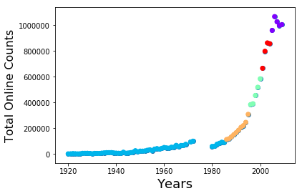
Clusters
Applied KNN algorithm with k as 5
1920-1985
1986-1995
1996-2000
2001-2004
2005-2009

Slide 17
Process
Data Extraction
Data Cleaning
Approach
Model Building
Results

Slide 18
Model building
Random Forest
Logistic Regression
Decision Tree
Bernoulli Naïve Bayes

Slide 19
Cluster | year | Model | Precision | Recall | F1-score
1 | 1920-1985 | Decision Tree Classifier | 0.77 | 0.75 | 0.75
 |  | Bernoulli NB | 0.77 | 0.76 | 0.75
 |  | Random Forest Classifier | 0.77 | 0.76 | 0.76
 |  | Logistic Regression | 0.78 | 0.76 | 0.76
Cluster | year | Model | Precision | Recall | F1-score
2 | 1986-1995 | Decision Tree Classifier | 0.82 | 0.79 | 0.78
 |  | Bernoulli Nb | 0.84 | 0.78 | 0.77
 |  | Random Forest Classifier | 0.82 | 0.79 | 0.78
 |  | Logistic Regression | 0.82 | 0.75 | 0.73

Slide 20
Cluster | year | Model | Precision | Recall | F1-score
1 | 1920-1985 | Decision Tree Classifier | 0.77 | 0.75 | 0.75
 |  | Bernoulli NB | 0.77 | 0.76 | 0.75
 |  | Random Forest Classifier | 0.77 | 0.76 | 0.76
 |  | Logistic Regression | 0.78 | 0.76 | 0.76
2 | 1986-1995 | Decision Tree Classifier | 0.82 | 0.79 | 0.78
 |  | Bernoulli NB | 0.84 | 0.78 | 0.77
 |  | Random Forest Classifier | 0.82 | 0.79 | 0.78
 |  | Logistic Regression | 0.82 | 0.75 | 0.73
3 | 1996-2000 | Decision Tree Classifier | 0.84 | 0.82 | 0.82
 |  | Bernoulli NB | 0.85 | 0.82 | 0.82
 |  | Random Forest Classifier | 0.84 | 0.82 | 0.82
 |  | Logistic Regression | 0.83 | 0.77 | 0.77
CLUSTER 1, 2, 3

Slide 21
Cluster 4 and 5
Cluster | year | Model | Precision | Recall | F1-score
4 | 2001-2004 | Decision Tree Classifier | 0.83 | 0.82 | 0.82
 |  | Bernoulli NB | 0.85 | 0.83 | 0.83
 |  | Random Forest Classifier | 0.83 | 0.82 | 0.82
 |  | Logistic Regression | 0.82 | 0.77 | 0.77
5 | 2005-2009 | Decision Tree Classifier | 0.77 | 0.76 | 0.76
 |  | Bernoulli NB | 0.79 | 0.77 | 0.77
 |  | Random Forest Classifier | 0.77 | 0.76 | 0.77
 |  | Logistic Regression | 0.73 | 0.74 | 0.73

Slide 22
Process
Data Extraction
Data Cleaning
Approach
Model Building
Results

Slide 23
Results
Model | Precision | Recall | F1-score
Decision Tree | 0.8 | 0.788 | 0.78
Random Forest | 0.806 | 0.79 | 0.79
Bernoulli NB | 0.82 | 0.79 | 0.788
Logistic Regression | 0.79 | 0.75 | 0.75

Slide 24
conclusion
Successfully created a model which predicts the long term impact of a paper on social media.
Future work includes including papers which have not appeared on social media and including features such as citations and h-index.

Slide 25

Questions?

